Slide 1
Ethernet over LTE and Broadband with ETX-203AX-T

Slide 2
Ethernet Services over Broadband/LTE
Scenarios:
Delivery of L2 services in “out of reach” locations
Fast delivery of L2 service while waiting for fiber connectivity
Uninterrupted business using an alternate link
Traffic load sharing over broadband/LTE
Notes:
We propose a way to pass CE to out of reach locations
We can do it fast, and not have to wait for the fiber to come
This allows minimum service down-time
In addition, we can utilize this solution to allow load sharing and/or service protection

Slide 3
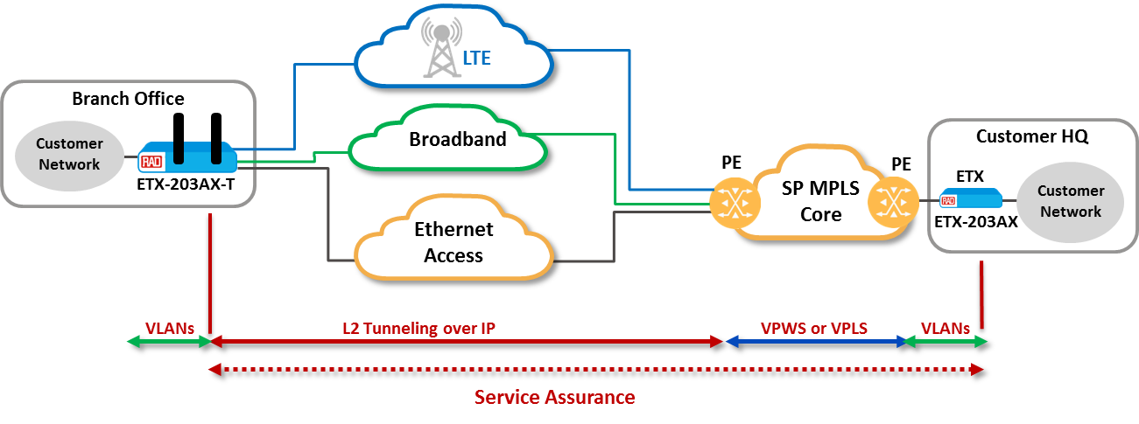
Ethernet Services over Broadband/LTE
Tunnel
Gateway
Implementation
Configure L2 services as in any ETX-2 family device
Tunnel L2 services over LTE or over Broadband
PE terminates tunnel, maps to VPWS or VPLS.
Management VLAN follows same process
Notes:
In order to deliver services over LTE or public IP networks, we have taken the ETX-203AX, RADs most successful L2 NID, and added secure tunneling capabilities. This new device is called ETX-203AX-T.

Slide 4
Assuring SLAs over LTE/BB
Bandwidth allocation controlled by carrier
SLA measurement and monitoring tools
Fallback and priority bumping to improve service availability
Advanced queueing and shaping for priority services
Notes:
To compensate on Hard SLA, the service provider can supply the service with more BW and provide SLA monitoring tools
When we use this connectivity for failure protection, or load sharing, it enhances the “regular” Business service
By using queuing, we can guarantee that very important services will always get precedence

Slide 5
Ethernet Services over Broadband/LTE
Benefits
New revenue streams
Shorter Time to Revenue
Increased customer loyalty
Cost savings on access (no fiber)
Alternative backup solutions
Overlay Transport over LTE or Broadband
Branch
Broadband
Cloud
LTE
Branches
Customer
Network
IP/MPLS/ Ethernet
Enterprise HQ
ETX-203AX-T
Assured Underlay Transport
Notes:
Passing CE over LTE/BB, we actually define a new revenue stream
LTE and BB allow a quick time to service
Connecting the customer where ever he is located, increases customer stickiness, while reducing operational costs.
When adding this backup option, it broadens our offering

Slide 6
Use Cases

Slide 7
Service Extension over LTE/BB
Fast Time-to-Quote incl. OOF sites
Inexpensive E-Access alternatives
Fully interoperable with on-net EADs (Y.1731, Y.1564, E-LINE, E-LAN,.. )
Cost-effective backup
ETX-203AX-T
Branch
Fixed line Connection
LTE Connection
HQ
LTE Network
PE
ETX-203AX-T
Fixed line Connection
IP/MPLS/ETH
Branch
Fixed line Connection
Connecting Out Of Reach Customer Over LTE
L2 tunnel over IP
Notes:
The simplest way to use this approach is by connecting a remote branch (which is out of our network reach).
This solution is fast, secure and it includes full SLA visibility

Slide 8
Setting New Customer Site Using LTE/BB
Value add Services e.g. load balancing
Fallback to improve service availability
Fully interoperable with on-net EADs (Y.1731, Y.1564, E-LINE, E-LAN,.. )
LTE Network
HQ
LTE Connection
PE
IP/MPLS/ETH
ETX-203AX-T
Fixed line Connection
Branch
L2 tunnel over IP
Service Protection Over LTE
Notes:
The second use case, can be actually a second phase to the previous use-case, where we first connect the remote branch for the needed period to bring the fiber to the building, and then, instead of just connecting the customer to you fiber, you keep the LTE/BB connection as a secondary link, and use it for service protection.
You can use this topology to do load balancing, and off load unimportant services from the expensive business LL

Slide 9
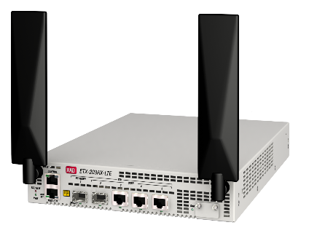
Introducing ETX-203AX-T
Premium, telco grade ETX-203AX-T EAD
New Capabilities:
Combines CE2.0 services with BB or LTE/4G accessibility
Secure Tunneling of Ethernet flows over IP networks
L2 over IP/GRE or L2TPv3
Interoperable with all leading PE vendors
IPsec encryption
Fragmentation
Hardware:
½ 19” metal enclosure with 5x GbE ports (SFP/UTP)
Wide range AC/DC power supply
SIM card slot (secured front access)
Dual external antenna
0-50C operation temp (fanless)
Ordering options:
ETX-203AX-T: Ethernet and Broadband WAN ports
ETX-203AX-T/LTE: Ethernet and LTE WAN ports
NA, EMEA and APAC options
LTE CAT 4 with 3G fallback

Slide 10
LTE specifications
ETX-203AX-T/LTE/2SFP/3UTP/L*
*Ordering Code | Specification
L1 | EMEA/Korea/Thailand LTE FDD: B1/B3/B5/B7/B8/B20 LTE TDD: B38/B40/B41 WCDMA: B1/B5/B8 GSM: B3/B8
L2 | North America LTE FDD: B2/B4/B12 WCDMA: B2/B4/B5
L3 | Australia/New Zealand/Taiwan/Brazil LTE FDD: B1/B2/B3/B4/B5/B7/B8/B28 LTE TDD: B40 WCDMA: B1/B2/B5/B8 GSM: B2/B3/B5/B8
L4 | North America LTE FDD: B2, B4, B5, B12, B13, B14, B66, B71 WCDMA: B2/B4/B5
Data Rates
LTE :
LTE FDD: Max 150Mbps (DL)/Max 50Mbps (UL) (Cat 4)
LTE TDD: Max 130Mbps (DL)/Max 35Mbps (UL) (Cat 4)
UMTS:
DC-HSDPA: Max 42Mbps (DL)
HSUPA: Max 5.76Mbps (UL)
WCDMA: Max 384Kbps (DL)/Max 384Kbps (UL)
GSM:
EDGE: Max 296Kbps (DL)/Max 236.8Kbps (UL)
GPRS: Max 107Kbps (DL)/Max 85.6Kbps (UL)

Slide 11
ZTP deployment – How it works
Service Request
ZTP Back-office Preparation at NOC
Assign CPE ID to customer ID
Select CPE profile from service catalog
CPE profile automatically stored in bootstrap server
EAD CPE Shipped to End-user
Physical installation by end-user
Connect CPE to power & networks
Service Activation
EAD CPE Zero Touch Process:
Fully automatic process
Get Device initial IP address from DHCP server
Open L2TPv3 tunnel to the PE router
Download CPE profile/SW
Connects securely to RADview for lifecycle management and monitoring
Back office
Pre-Staging
By RAD or service provider
Install ZTP SW and certificates
Label CPE/carton with CPE ID
Pre-configure PE router IP address
• Faster, simpler rollouts • No on-site technicians • Immediate revenues

Slide 12
Amos (Ami) Sofer
Product Line Manager
ami_so@rad.com

